Slide 1




02 March 2026
Cancer Serve Website Monthly Report Analysis

Slide 2


02 March 2026
This report aims to analyze the website's performance for February 2025, focusing on traffic, user flow, traffic sources, demographics, behaviors, and security.
What Is The Purpose Of This Report?
Key metrics
Traffic overview
Audience demographics
Behavior analysis
Acquisition channels
Conversion tracking
Areas Of Focus:

Slide 3

02 March 2026
Summary
Performance of the website based on data insights
In the past month, the Cancer Serve website attracted a total of 231 active users, with 225 being new and 14 returning users. The majority of users accessed the site through direct search (195 users), while smaller numbers came via organic search (43). China contributed the highest traffic, with 99 users. On average, users engaged with the site for 18s seconds per session.

Slide 4
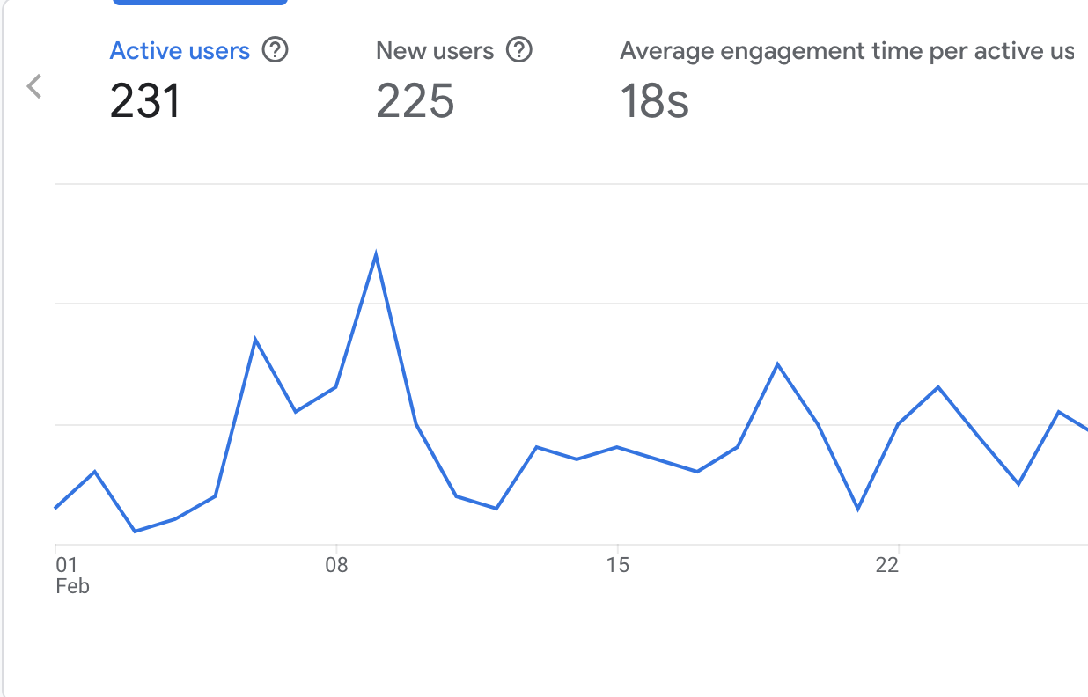
02 March 2026
Site Overview
Emphasizing the important numerical data, the large line chart on the right displays the key metrics for the Cancer Serve website from the previous month.
It shows:
Users : 231 total users visited the site.
New Users : 225 new users, indicating most visitors were first-time visitors.
Average Engagement Time : Users spent an average of 18s seconds on the site.

Slide 5
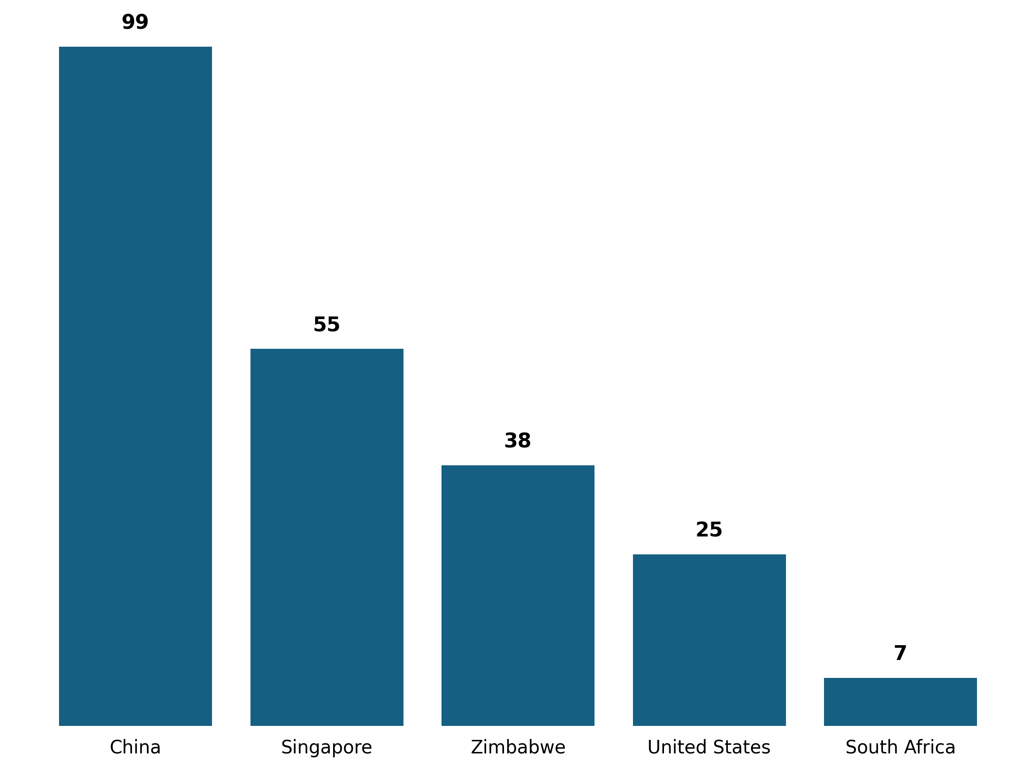
02 March 2026
Demographic Overview
Most of the traffic is coming from China (99users) , followed by Singapore with (55 users) then Zimbabwe with (38 users) and United States with (25 users) each.

Slide 6
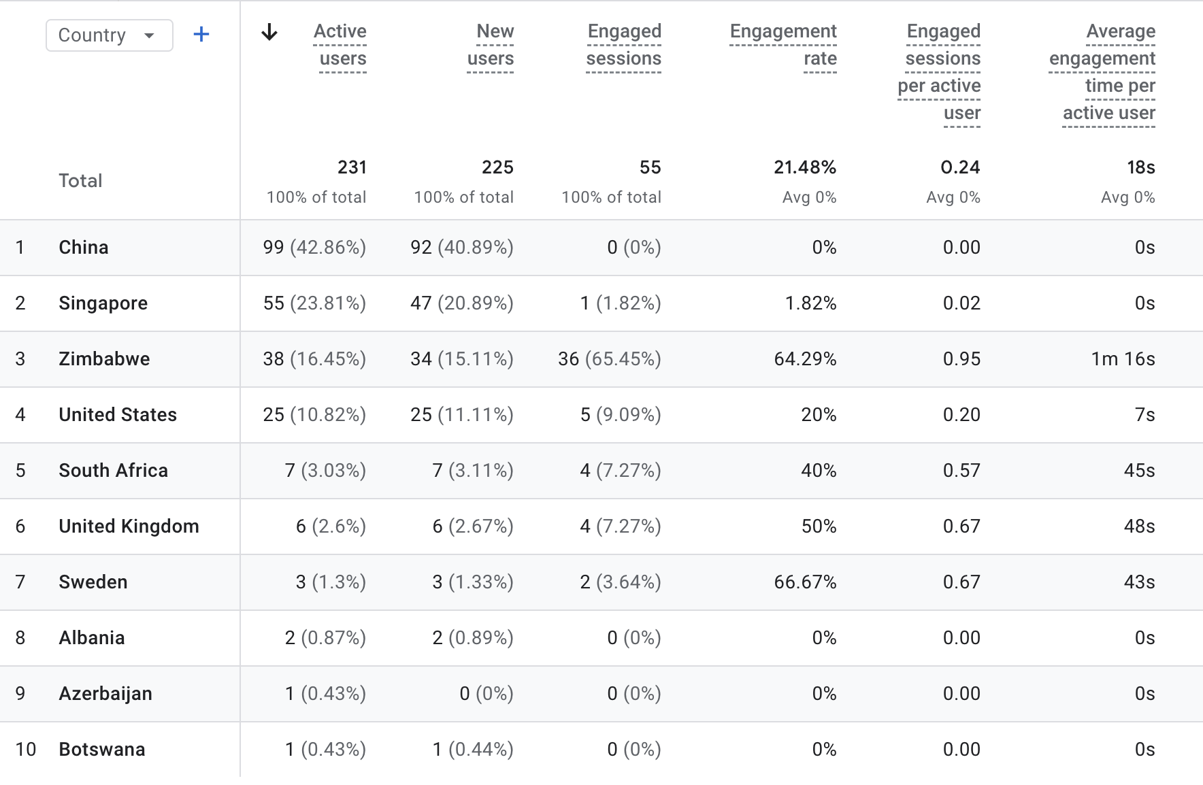
02 March 2026
Demographic Overview

Slide 7
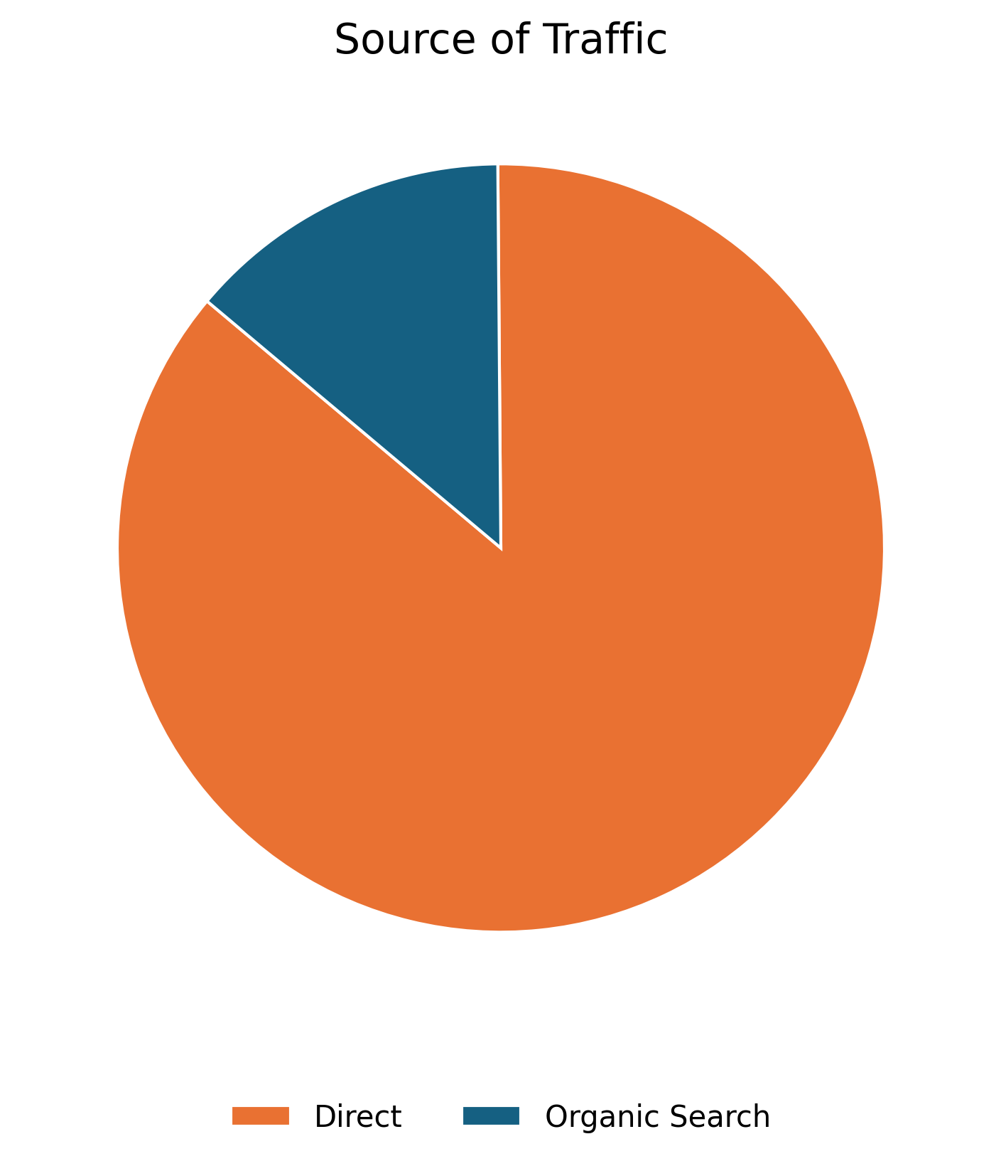
01 July 2025
User Acquisition
The data on this slide illustrates the various traffic channels bringing users to the Cancer Serve website. The pie chart reveals that the majority of traffic comes from Direct Search.
Source | Users43
Direct | 188
Organic Search | 30

Slide 8
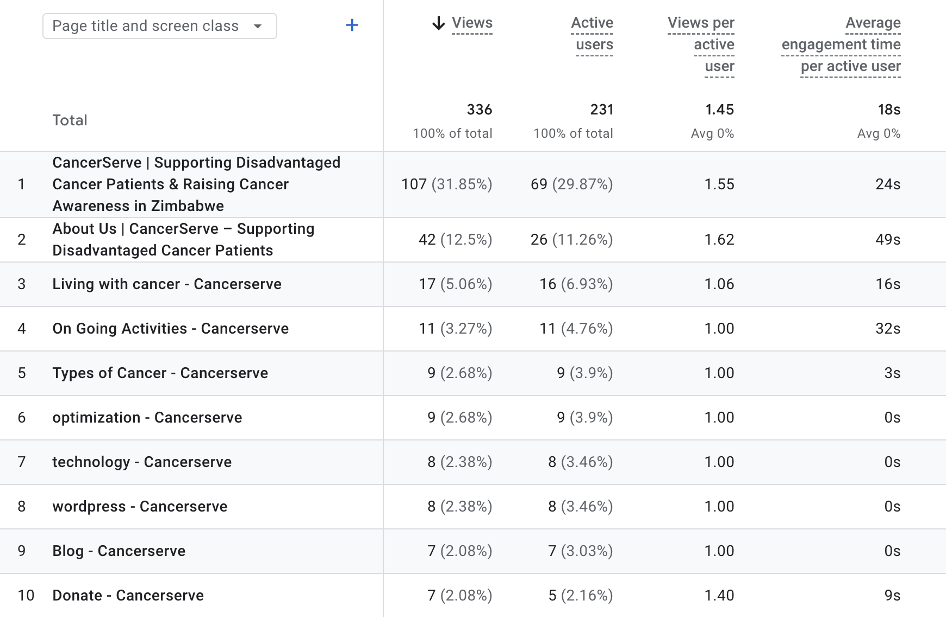

02 March 2026
Pages Sessions
The table shows the top pages visited by users in the previous month

Slide 9
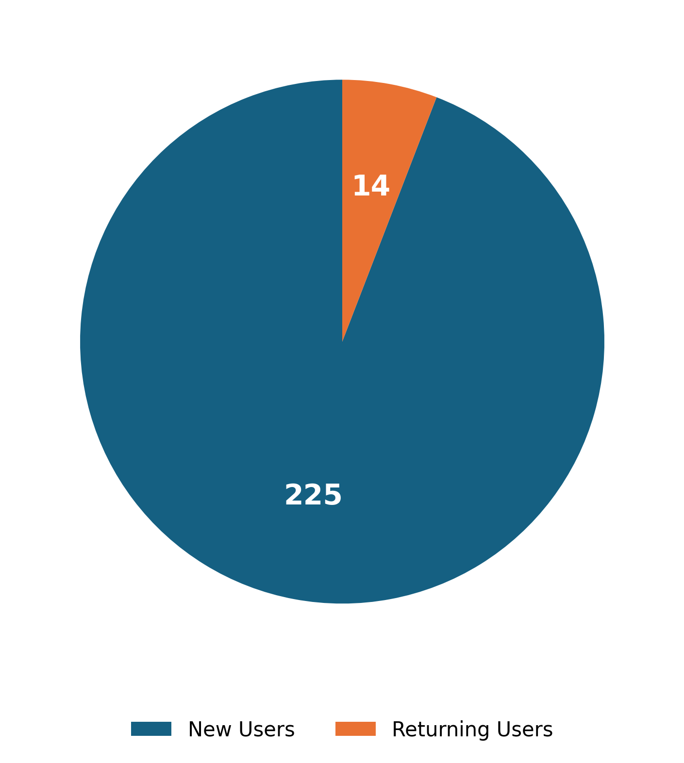
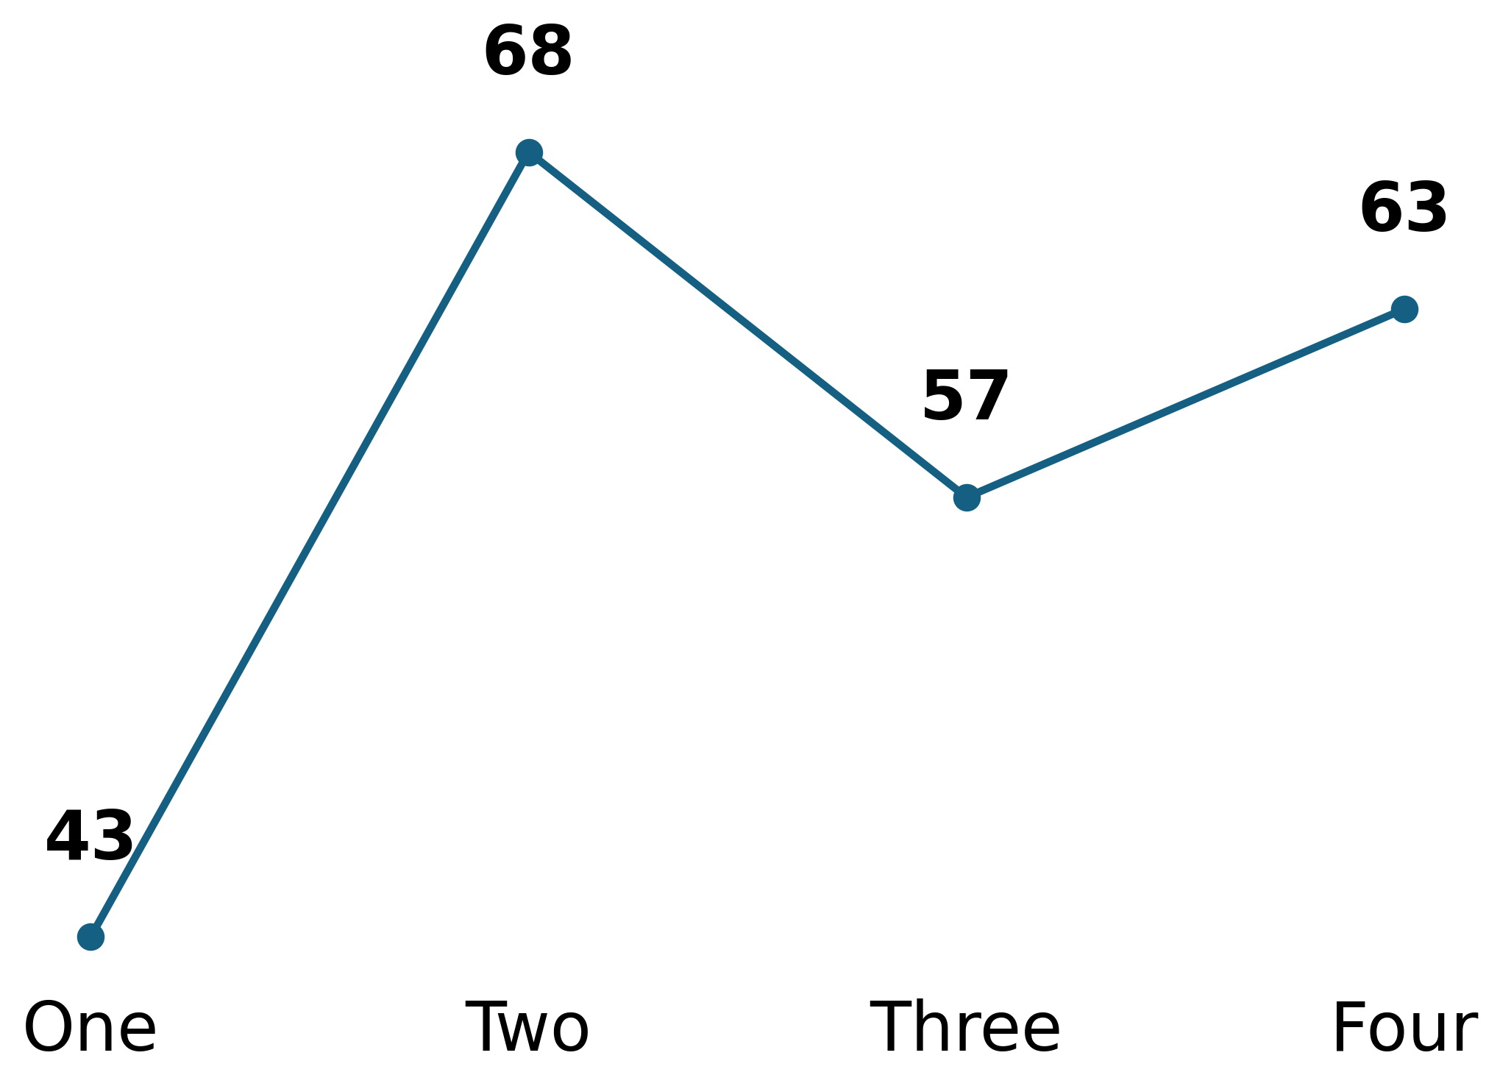
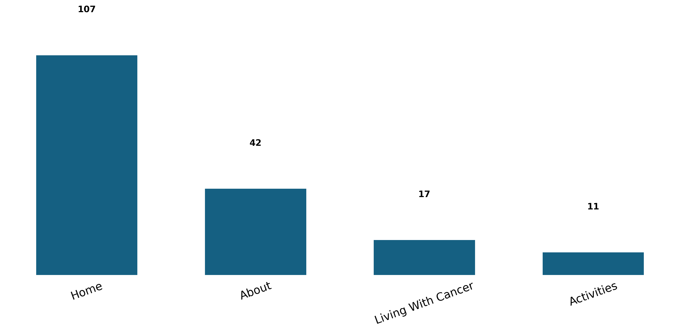
02 March 2026
Behavior Analysis
Users
Engagement Rate Per Week
Page Views
Based on user interactions.
Measure user interaction.
Track page visits.

Slide 10
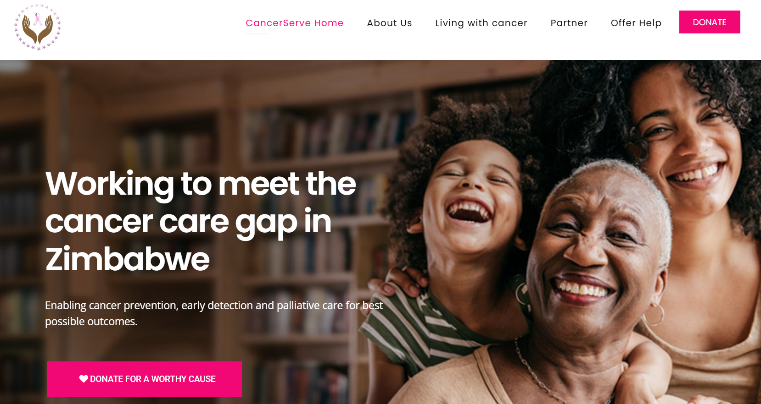
02 March 2026
Recommendations
Based on data insights
1. Enhance User Engagement: Integrate a "How to Help" checklist and donation impact stories directly on the Home and About pages to drive meaningful interaction.
2. Increase Returning Users: Launch a "Patient Journey" series featuring monthly video updates on support initiatives and community impact stories to build a loyal following.
3. Expand Geographic Reach: Optimize the Living With Cancer and Activities sections with international SEO keywords to attract broader diaspora and global support.

